Slide 1
NAME : Viraj Jigar Patel BRANCH : B.Tech CSE BDA ENROLLMENT NUMBER : BDA-06 SEM : 1st sem COLLEGE : Ganpat University
PROJECT DEFINITION NUMBER : PID-149

Slide 2
INTRODUCTION REGARDING THE PROJECT DEFINITION
CHALLENGE TITLE :-
Location Based Crime Analysis and Mapping.
NAME OF THE DEPARTMENT :-
Women & Child Development Department.
CHALLENGE DESCRIPTION :-
Getting details of various types of violence against women in the state,especially in case of domestic violence, sexual abuse, teasing, rape,dowry, child marriage, sexual harassment and status of infanticide orany incident where violence takes place.
Because of the conservatism and mentality of the society, the violence of women in some areas of the state / districts continues to increase. If there is accurate information about the status of women's violence in the area, it will help the Department to curb effectively.

Slide 3
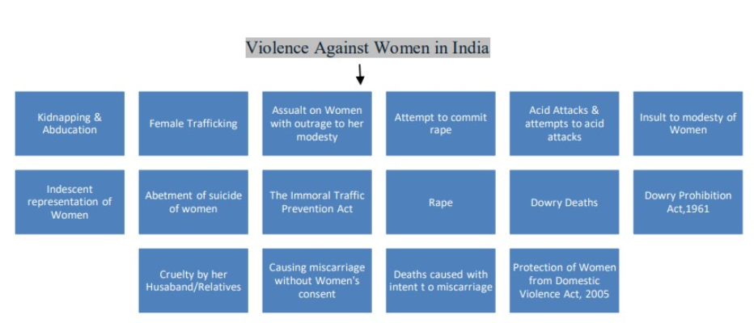
DETAILS OF VARIOUS TYPES OF VIOLENCE AGAINST WOMEN IN THE STATE
:- Domestic Violence
:- Sexual Abuse
:- Teasing
:- Rape
:- Dowry
:- Child Marriage
:- Sexual Harassment

Slide 4
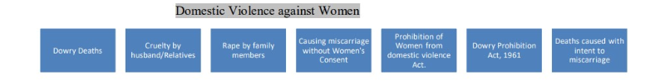
DOMESTIC VIOLENCE
Domestic violence is violence committed by someone in the victim’s domestic circle. This includes partners and ex-partners, immediate family members, other relatives and family friends.The term ‘domestic violence’ is used when there is a close relationship between the offender and the victim. There is usually a power gap between them. The victim is dependent on the offender. Domestic violence can take the form of physical, sexual or psychological abuse.Forms of domestic violence.
The following are forms of domestic violence: child abuse; senior abuse; honour-based violence such as honour killings, female genital mutilation (‘female circumcision’) and forced marriage; all forms of abuse by an intimate partner or former intimate partner, including psychological abuse and stalking.
Victims of domestic violence Women form the largest group of victims. However, men, children and elderly people can also be victims of domestic violence. Domestic violence occurs at all levels in society and in all population groups.Abuse is usually deliberate, but not always. For example, sometimes people can no longer cope with caring for relatives. The situation can then escalate and result in abuse. A total of 133154 cases have been reported under Domestic Violence against Women in India. The most prevalent form of Domestic Violence in India (as per NCRB Report , 2016) is Cruelty by Husband/ Relatives. 1,10,378 cases have been reported under this crime in 2016 in India which accounts for 82.9% of total domestic violence against Women in India

Slide 5
SEXUAL ABUSE
What is sexual abuse?
Sexual abuse is sexual behavior or a sexual act forced upon a woman, man or child without their consent. Sexual abuse includes abuse of a woman, man or child by a man, woman or child.Sexual abuse is an act of violence which the attacker uses against someone they perceive as weaker than them. It does not come from an uncontrollable sex drive, but is a crime committed deliberately with the goal of controlling and humiliating the victim.Most victims of sexual violence are women – a fact that reflects their social stance even today, in the 21st century, as inferior to men. Sexual violence is another means of oppressing women in a patriarchal society.Sexual violence is a social phenomenon that exists in every society that accepts aggressive behavior and gender inequality, and Israel is among them. Thousands of women turn to the rape crisis centers for help after an attack, and the statistics show that 1 in 3 women will be sexually abused during their lifetime.
Types of sexual assaults : Rape ,Sodomy,Attempted rape ,Gang rape,Serial rape ,Incest
Sexual Assault :
Section 354 of the Indian Penal Code provides that: “Whoever assaults or uses criminal force to any woman, intending to outrage or knowing it to be likely that he will thereby outrage her modesty, shall be punished with imprisonment of either description for a term which may extend to two years, or with fine, or with both". The various forms of assault on women that have been included under this are Stalking, Voyeurism, Sexual harassment, Assault on Women and Assault/use of criminal force with intent to disrobe identity of women. A total of 84,746 cases have been reported under assault on women in 2016(as per NCRB report).Maharashtra reported the highest cases (11,396 cases) in 2016 followed by Uttar Pradesh(11,335 cases) followed by Madhya Pradesh(8717 cases). Delhi reported a highest crime rate of 43.6 (4165 cases per lakh female population) followed by Orissa with crime rate of 39.1(8252 cases per lakh female population). Lakshwadeep and D&N Haveli have reported lowest number of cases (1 case) of assault on women with intent to outrage to her modesty in 2016. POCSO Act, 2012 is a comprehensive law to provide for the protection of children from offences of sexual assault, sexual harassment and pornography. It requires special treatment of cases relating to child sexual abuse such as setting-up of special courts, special prosecutors, and support persons for child victims.

Slide 6
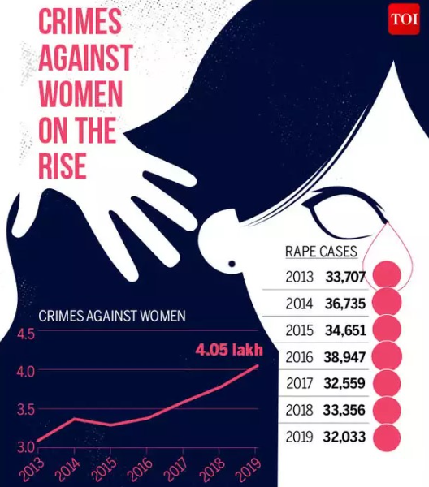
RAPE
India is known to be one of the most dangerous countries in the world for women. Indian women are constantly in a state of high alert when alone on the streets, at work or in the markets. Due to India’s predominantly patriarchal nature, domestic violence is known to be culturally acceptable. Studies reveal that even a majority of working women suffer domestic abuse from their husbands. A non-earning woman’s position further exacerbates vulnerability and dependence on their male partner as opposed to a woman who contributors financially to the household. Rape is the fourth most common crime against women in India. According to the National Crime Records Bureau (NCRB) 2013 annual report, 24,923 rape cases were reported across India in 2012. Out of these, 24,470 were committed by someone known to the victim (98% of the cases).Rape of female is criminal offence under Section 375,376,376A, 376B, 376C and 376D of the Indian Penal Code . A total of 38,947 cases of rape have been reported in India in 2016 as per the report by NCRB. Madhya Pradesh reported highest rape cases (4882 cases) in 2016 followed by Uttar Pradesh (4816 cases) followed by Maharashtra (4189 cases). Sikkim reported highest crime rate (30.66) followed by National Capital, Delhi (22.57). Lakshwadeep & Puducherry reported least number of rape cases in 2016 with low crime rates. As many as 65,025 rape cases were reported in 2021 in India and the accused were known to the victims in 96.8 per cent of the cases, the National Crime Records Bureau (NCRB) data revealed. Rajasthan recorded the maximum number of rape cases at 6,337, followed by Madhya Pradesh (2,947) and Uttar Pradesh (2,845)
10 Shocking Rape Cases That Shook The Whole Country : 1. Nirbhaya Rape Case 2. 2019 Hyderabad Rape Case 3. Unnao Rape Case 4. Hathras Gangrape Case 5. Kathua Rape Case 6. Badaun Rape Case 7. Shakti Mills Rape Case 8. Jisha Rape Case 9. Suzette Jordan Rape Case 10. Franco Mulakkal Rape Case

Slide 7
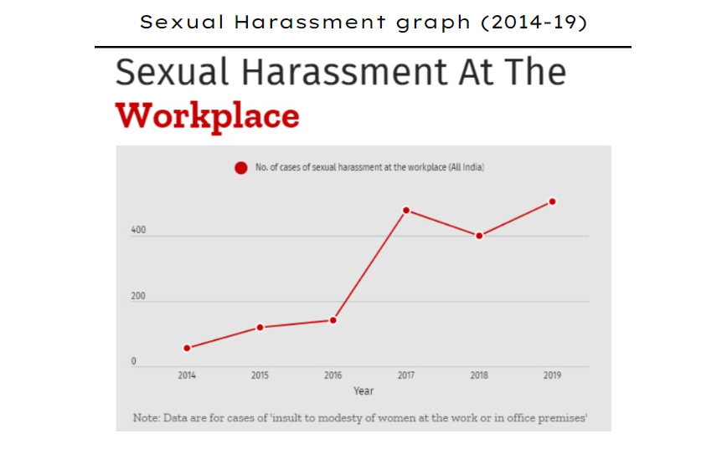
SEXUAL HARASSMENT
Sexual harassment is any unwanted sexual behaviour that makes someone feel upset, scared, offended or humiliated, or is meant to make them feel that way. Sexual harassment is a type of of sexual violence – the phrase we use to describe any sexual activity or act that happened without consent. E xamples of harassment in the workplace include derogatory jokes, racial slurs, personal insults, and expressions of disgust or intolerance tow ard a particular race. Abuse may range from mocking a worker's accent to psychologically intimidating employees by making threats or displaying discriminatory symbols. Sexual harassment is frequently overlooked in India, even in the age of the MeToo movement which saw survivors share their stories and led to the downfall of numerous public figures worldwide, in politics, business, the entertainment industry, and beyond. India was no exception to this trend, with women from all walks of life sharing their stories of sexual harassment. Nonetheless, the practice remains a depressingly common phenomenon in India, where a woman is sexually harassed every twelve minutes . According to statistics recently released by the National Crime Records Bureau (NCRB), of states, Uttar Pradesh recorded the most sexual harassment cases that year, with 5,830. Madhya Pradesh followed with 2,985 cases, with Maharashtra placing third, reporting 2,910 cases. Of cities, Delhi recorded the most cases of sexual harassment in India in 2017, with 613, followed by Mumbai, with 391, and Kanpur, with 162. Telangana recorded more cases of sexual harassment in the workplace than any other state. Bihar was the state to record the most cases of sexual harassment on public transport. The NCRB data highlighted the plight of women in shelter homes. The maximum number of cases of sexual harassment in shelter homes was reported in Pune, followed by Mumbai. Uttar Pradesh reported more sexual harassment cases in shelter homes than any other state (239), followed by Andhra Pradesh (65) and Maharashtra (64). “[Fewer than] one percent of sexual harassment cases [in shelter homes] come out,” reported Lek Ladki Abhiyan, a movement focused on the issues facing Maharashtra’s girls and women. “This is because such shelters are operated by party workers. We have repeatedly approached the government to introduce an SOP [standard operating procedure] but there is no positive reply.” “The internal committees that are set up both in government and private sectors do not have the teeth to act on complaints of sexual harassment,” said Maharashtra State Commission for Women chairperson Vijaya Rahatkar. “Members of such committees are not aware of the law and are afraid of taking any action against seniors. This was one of the reasons few people coming forward to lodge complaints. We have asked the government to make it compulsory for the staff of corporate sector to undergo online training on sexual harassment to make them aware of their rights.”

Slide 8
THANK YOU FOR VIEWING THE PREVIOUS PAGES GIVEN THEY ALL ARE CONTAINING INFORMATION ABOUT THE CRIMES WHICH ARE DONE WITH WOMEN AND GIRLS AND CHILD FURTHER WE CAN THINK ABOUT THE WELFARE.
THANK YOU FOR VISITING………….

